Slide 1
Tests Unitaires
Présentateur : Phuong Vu NGUYEN

Slide 2
Contenu
I
Test unitaire
Framework Specflow
II
III
Q&A

Slide 3
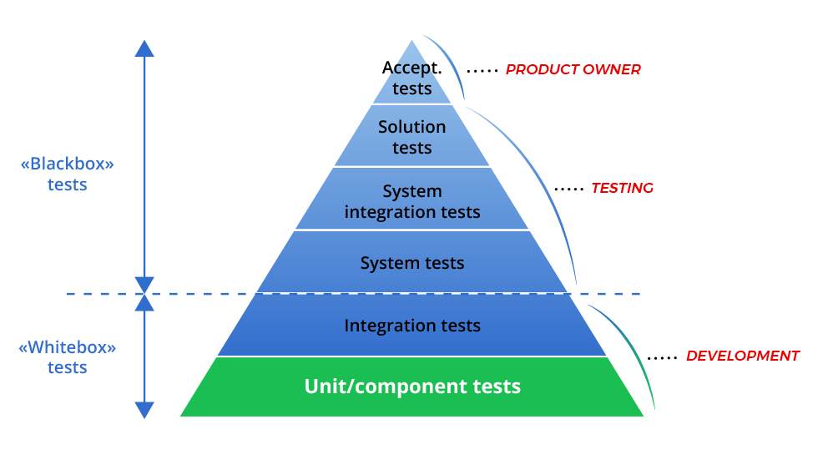
Types de Test
Test Unitaire | SpecFlow | Q&A
Source : https://blog.atinternet.com/fr/pourquoi-investir-dans-les-tests-unitaires/
Notes:
- Réduire des bugs 90%

Slide 4








Pourquoi tests unitaires
Test Unitaire | SpecFlow | Q&A
Source : https://www.typemock.com/7-benefits-of-unit-testing/

Slide 5
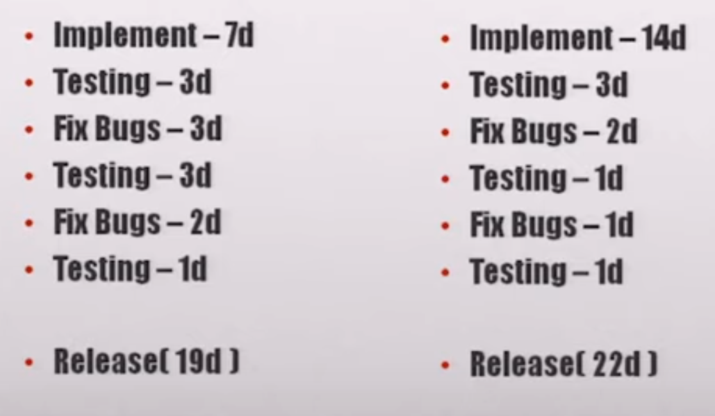
TUs prends double temps de développement ?
Test Unitaire | SpecFlow | Q&A
Roy Osherove - Unit Testing and TDD: Why you should care and how to make it happen : https://www.youtube.com/watch?v=3_UX8Kqb3aU https://www.manning.com/books/the-art-of-unit-testing-second-edition

Slide 6
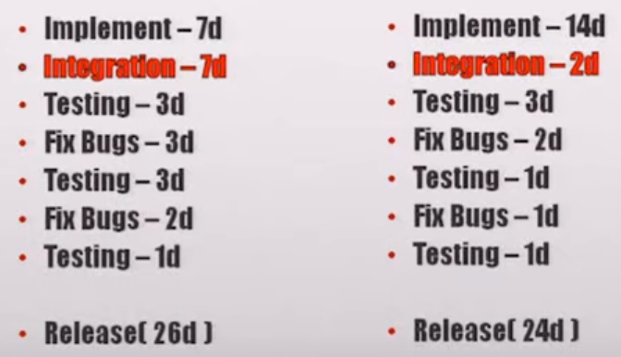
TUs prends double temps de développement ?
Test Unitaire | SpecFlow | Q&A
Roy Osherove - Unit Testing and TDD: Why you should care and how to make it happen : https://www.youtube.com/watch?v=3_UX8Kqb3aU https://www.manning.com/books/the-art-of-unit-testing-second-edition

Slide 7
Bonnes Pratiques
Test Unitaire | SpecFlow | Q&A
Restreints
Rapide
Automatisé
Stable dans le temps
Indépendant
Roy Osherove - Unit Testing and TDD: Why you should care and how to make it happen : https://www.youtube.com/watch?v=3_UX8Kqb3aU https://www.manning.com/books/the-art-of-unit-testing-second-edition

Slide 8
Test Unitaire | SpecFlow | Q&A
Site web : https://specflow.org/
Course : https://app.pluralsight.com/course-player?courseId=2d108502-d689-4683-9ae8-345fa8d17466
ScenarioContext : https://www.toolsqa.com/specflow/scenariocontext-current-in-specflow/

Slide 9

Hoạt động AEVS | SpecFlow | Q&A

Slide 10
Merci !

